Slide 1
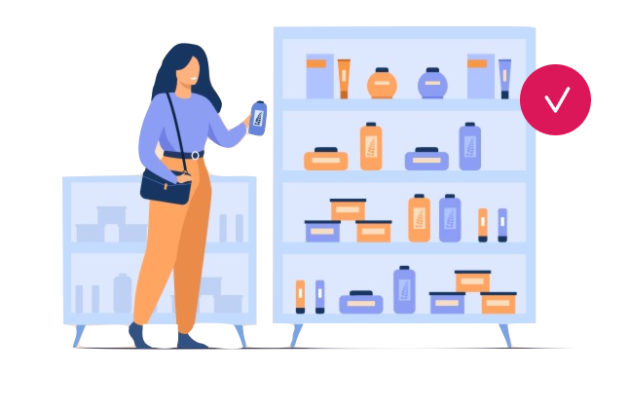
FACTSHEET
Start of Day
Checklist
WorkApp
Talk to Sales
Sign up for FREE
Introduction
With the Wooqer Start of Day WorkApp, get your Store Managers out of the back room and onto the shop floor to do the Start of Day checks, reporting completion, with evidence to support as they do so. The Wooqer 360 Dashboard brings you real-time visibility into the completion status at each location and visibility into open issues.
WorkApp details
Industries
Retail
Restaurant
Functions
Operations
Sales
Variants available
Lifestyle Retail
Jewelry
Eyewear
Grocery
Restaurant
+ more on request
Creator
Store Coherence
Evolving since
2014
Configure
& Launch
Get evidence backed updates during walkthrough
Get notified of misses. See reports
Publish Scorecard. Build accountability
Enabling features
Configurable WorkApp
Auto-Assignment
Auto-report sharing
Auto-Reminders
Offline Mode
Geo-fencing
Live Camera pictures
Date | Time Stamp
Video evidence
Completion report
Compliance Report
One-click task creation
Report download - Excel
Wooqer 360 dashboard
Visual Gallery
Escalation Notifications
Integration API
+ more
FAQs
Can I customize the workApp?
Yes, a whole lot of customizations are possible, ranging from the periodicity, sections, subsections, fields, name of the workApp, your personalized branding, workflow mapping and much more. Talk to Sales for specifics.
What insights does this workApp enable?
With this workApp you can :
Know which locations or teams need assistance today
Get insights to improve the Standard Operating Processes (SOPs)
Identify training needs and plan interventions
What IT infrastructure or IT team involvement do I need to use this workApp?
All you need is the devices where your users can use Wooqer and internet connectivity in form of Mobile data, Wifi or Broadband connection. The App works on both iOS and Android devices. No IT team involvement is needed except to whitelist the Wooqer IP and mails from Wooqer where firewalls may block such access.

Slide 2
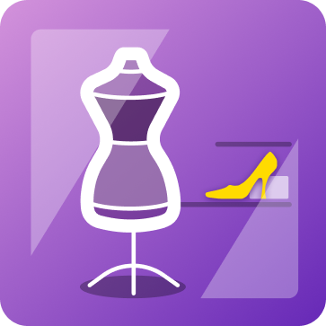
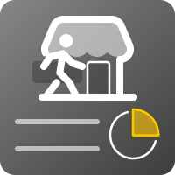
App in numbers
100+
40000+
50000+
7000000+
Brands
Locations
Users
Start of days
Business Impact
150 mins
more per day on the shop floor
100%
99%
6X
100%
Visibility
Compliance
Frequency
Consistent
Where is the data stored? Who owns it and how does Wooqer ensure data security?
Your data (including images) submitted on the App are owned entirely by you and Wooqer claims no ownership of your data. We do not access or use your data in any form except basic industry benchmarking or towards support requested by you. The data is stored on the cloud on Wooqer servers and is absolutely secure. We undergo stringent security procedures and audits to ensure that your data is never at risk.
What are the integration possibilities available with the workApp?
The workApp can integrate with any other tools using available APIs. With these APIs, data from another system can be brought into the workApp and data from the workApp can be taken to other systems
What does it take to get started?
You can be up and running with this workApp within 4 hours! All you need to do is to
Customize the workApp if needed, set reminders/ notifications and activate workApp
Upload your store and user list on Wooqer and invite user to use the workApp.
Start tracking reports
About Wooqer
Wooqer is an App for Ops that brings you ready to use WorkApps through the Wooqer Marketplace. Wooqer WorkApps have been built in partnership with industry experts and give you a headstart not just in your digitization journey but also in your process definition or improvement efforts. All Apps can be quickly and easily customized without any IT or Wooqer team dependence using the Wooqer Creator toolset. You can also use the Creator toolset to create new WorkApps on the go.
About Store Coherence
Store Coherence is a Wooqer Creator with expertise in the domain of Store Operations Management. The Brand brings you a series of WorkApps that are now proven on the ground!
Related WorkApps
End of Day Report
Visual Merchandising
Changeover
Store Visit Report
Get secure and timely closures with readiness to reopen
Ensure consistent customer experience across stores
Build strong control with credible evidence based audits
Learn more
Learn more
Learn more

